Slide 1
PIZZA SALES REPORT

Slide 2
Introduction
THIS COMPLETE PROJECT IS ABOUT THE PIZZA SALES AND USING THIS DATA, CAME UP WITH THE VALUEABLE INSIGHTS IN A DASHBOARD.
THIS COMPLETE DATA SET HAS 12 COLUMNS AND TOTAL 48620 ROWS.
AND THE FIELDS OR TERMS WHICH THIS DATASET HAS ARE AS FOLLOWS:
PIZZA_ID, ORDER_ID, PIZZA_NAME_ID, QUANTITY, ORDER_DATE, ORDER_TIME, UNIT_PRICE, TOTAL_PRIZE, PIZZA_SIZE, PIZZA_CATEGORY, PIZZA_INGREDIENTS, PIZZA_NAME

Slide 3
PROBLEM statements
Daily Trend For Total Orders
Monthly Trend For Total Orders
Percentage Of Sales by pizza category
Percentage Of Sales by pizza Size
Total pizzas sold by pizza category
Top 5 Best sellers by revenue, total quantity and total orders
Bottom 5 Worst sellers by revenue, total quantity and total orders

Slide 4
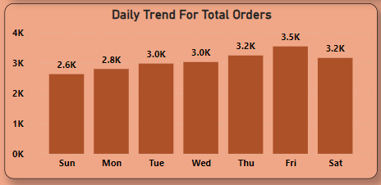
Daily Trend For Total Orders
INSIGHTS :-
Orders Are Highest On Friday And Saturday.

Slide 5
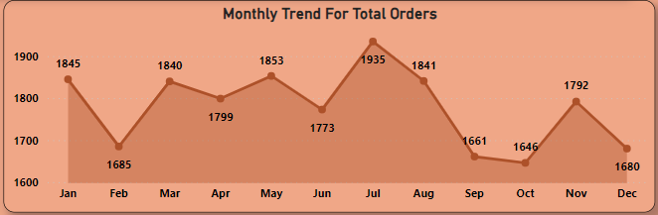
Monthly Trend For Total Orders
INSIGHTS :-
Maximum Orders From Month Of July And January.

Slide 6
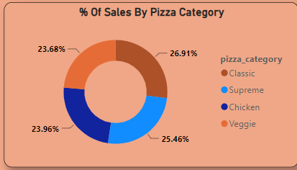
Percentage Of Sales by pizza category
INSIGHTS :-
Classic Category Contributes To Maximum Sales & Total Orders.

Slide 7
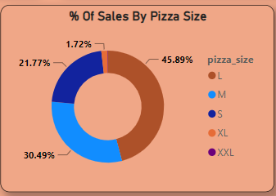
Percentage Of Sales by pizza Size
INSIGHTS :-
Large Size Pizza Contributes To Maximum Sales Which is 45.89%

Slide 8
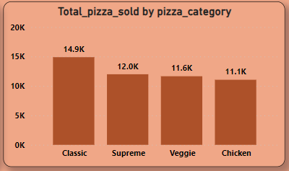
Total pizzas sold by pizza category
INSIGHTS :-
The Maximum Sold Pizza Category Is Classic Which is 14.9k

Slide 9
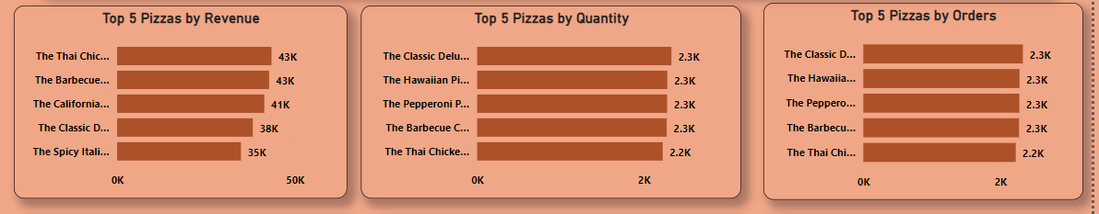
Top 5 Best sellers by revenue, total quantity and total orders

Slide 10
INSIGHTS :-
Revenue - The Chicken Pizza Contributes Maximum Revenue.
Quantity – The Classic Deluxe Pizza Contributes To Maximum Total Quantities.
Total Orders – The Classic Deluxe Pizza Contributes To Maximum Total Orders.

Slide 11
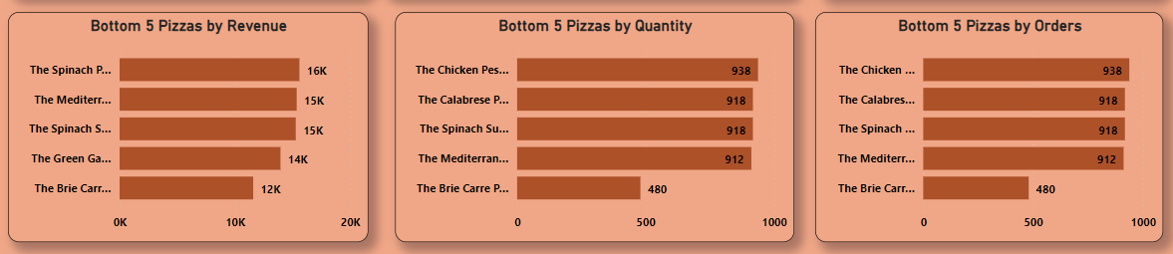
Bottom 5 Worst sellers by revenue, total quantity and total orders

Slide 12
INSIGHTS :-
Revenue - The Brie carre pizza contributes to manimum
revenue.
Quantity - The brie carre pizza contributes to minimum total.
Total Orders- The brie carre pizza contributes to minimum Total Orders.

Slide 13
DASHBOARD

Slide 14
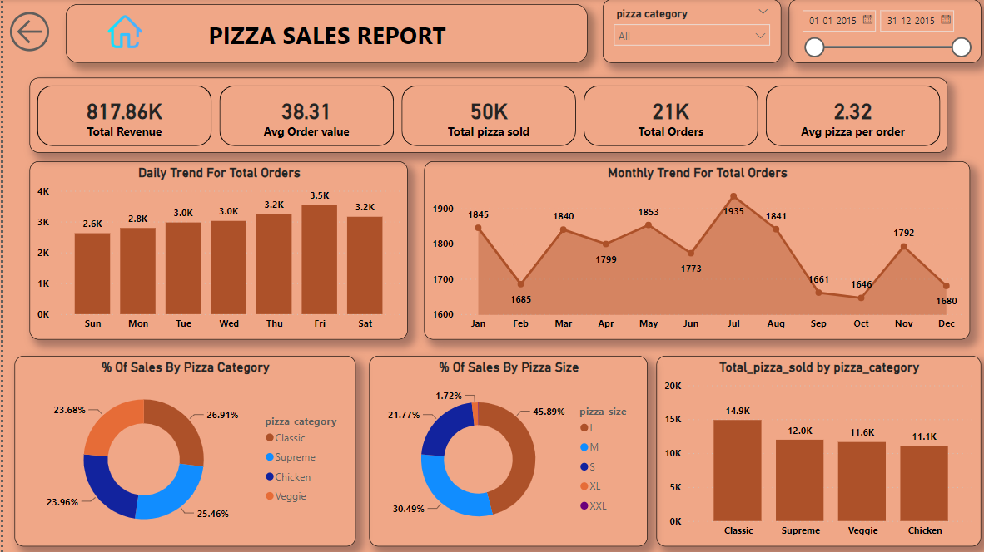

Slide 15
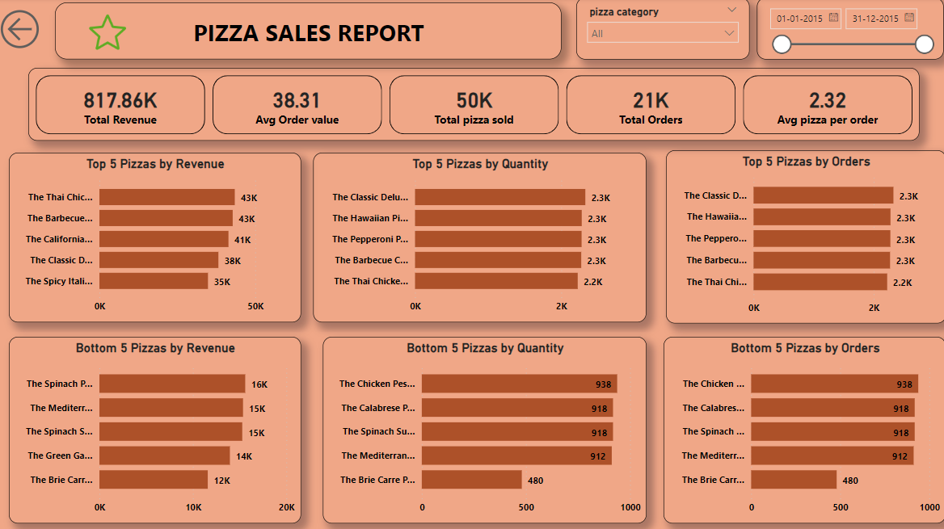

Slide 16
CONCLUSION
The Maximum Sold Pizza Category Is Classic Which is 14.9k
Large Size Of Pizza Contributes Maximum Sales Which is 45.89%
Maximum Sales On Friday And Maximum Orders Comes From Month Of July And January.
The Classic Deluxe Pizza Contributes To Maximum Total Orders.
The brie carre pizza contributes to minimum Total Orders

Slide 17
THANK YOU

